Slide 1
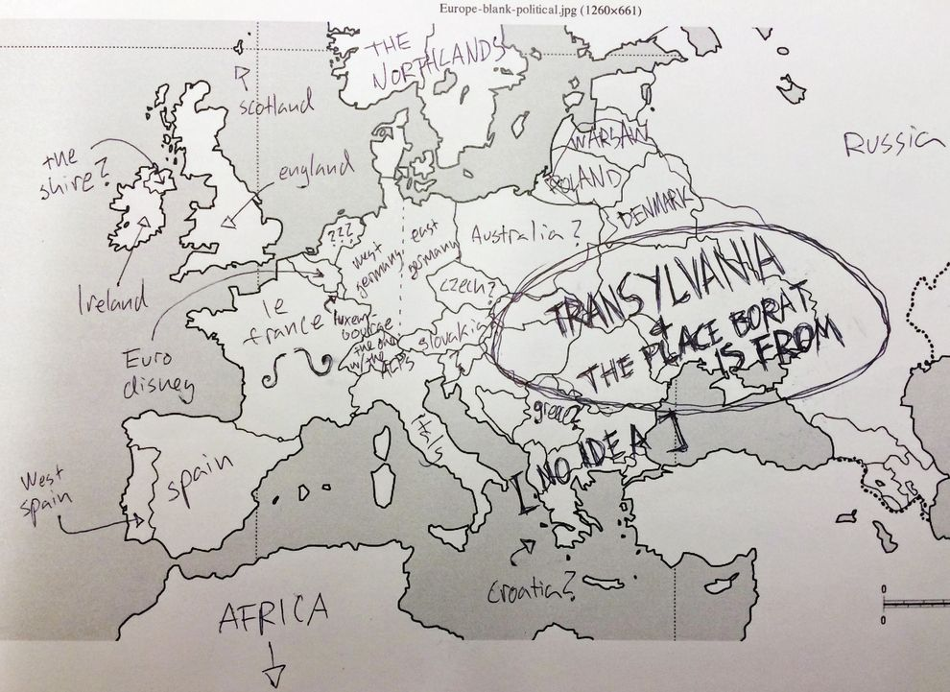
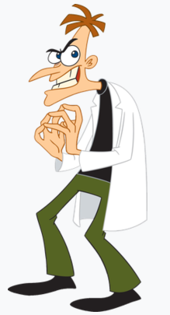
“As they say in China, Arrivederci!”
Disney’s Dr. Heinz Doofenshmirtz and the Map of the Eastern European Accent in the American Imagination
https://i.pinimg.com/originals/c2/25/41/c2254189d20e57078ced7a575061ce83.jpg
Giota Papavasileiou, Albert-Ludwigs Universität Freiburg
68.StuTS 19-22.11.2020, Berlin

Slide 2
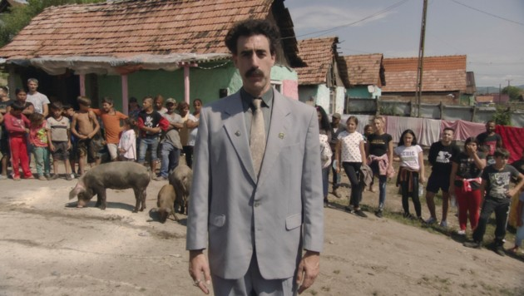
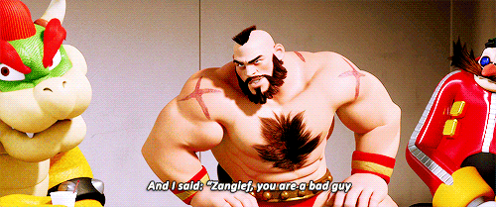
Linguistic Stereotyping & the Eastern European Accent
How does a hero speak? How does a villain?
-standard linguistic variety Vs. foreign/ regional/ socioeconomically marked accent
-reproduction of problematic ideologies related to linguistic variation
-news trends? (Azad 2009)
The “pan-Slavic” stereotype (Wallace 2008, p. 35)
-unclear cultural/linguistic heritage
-male
-primitive
-brutal
-not educated
https://nl.pinterest.com/pin/488077678341107415/
https://www.krone.at/2259451
https://i.gifer.com/78FM.gif

Slide 3
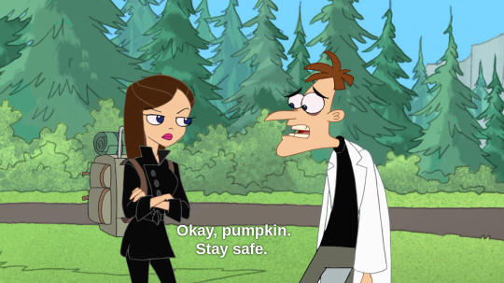
Heinz Doofenshmirtz, an Immigrant from Drusselstein
Multicultural identity and characteristics: supposed to be German/ Austrian, but his accent is Eastern European
Multiple backstories from his country that reconstruct his childhood trauma (and hence explain his ‘evilness’)
Not only a villain, but also a divorced father; character with a past, present & future

Slide 4
Data & Methods
Survey (questionnaire)
Romanian, Russian & Ukrainian native speakers (20 in total)
https://www.youtube.com/watch?v=ST0ayVGjc3U&t=99s (video sample: All Doofenshmirtz backstories)
Try to identify the accent: What could the mother tongue of the speaker be based on his accent?
What are the features of the character’s speech that helped you to identify his accent? Try to describe them.
Research Questions
Which languages are echoed in the Eastern European accent of Doofenshmirtz?
What are the stereotypical features of the accent?
How does the character’s portrayal relate to his accent?

Slide 5
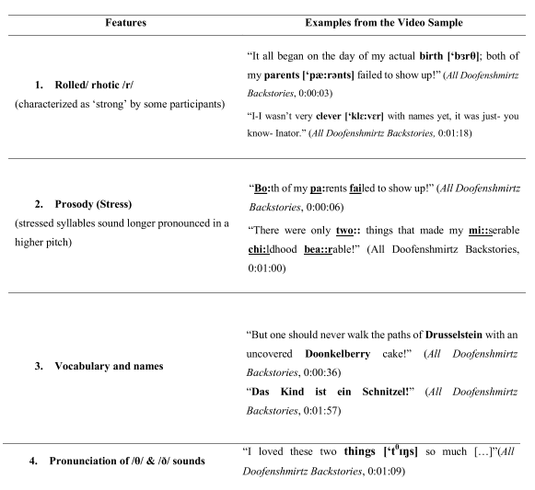
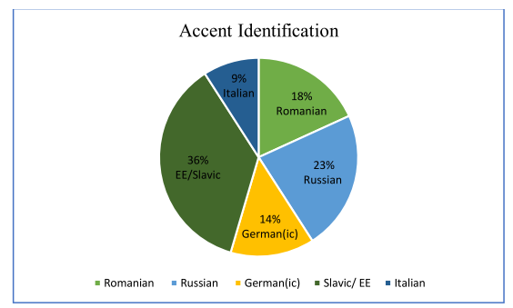
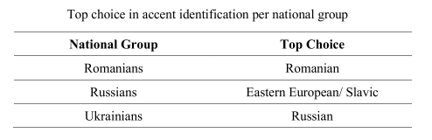
Results

Slide 6
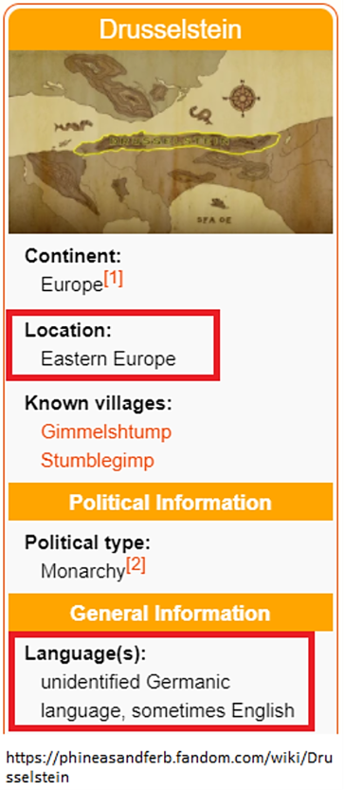
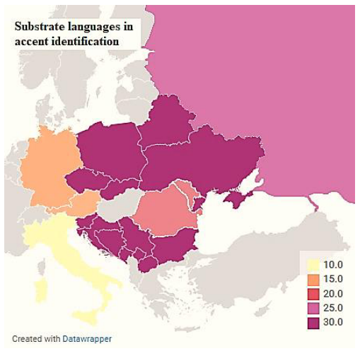
Conclusion
The linguistic perception of Eastern Europe is influenced by and perpetuates the misconception that it is a geographically and culturally homogenous place
The most prominent and hence most stereotyped features of the accent were reported to be the rolled /r/ sound and the stress, among others
Doofenschmirtz seems to contradict the stereotype of the (pan-)Slavic man directly associated to his accent
The bottom line, nonetheless, remains the same: foreign is evil.

Slide 7
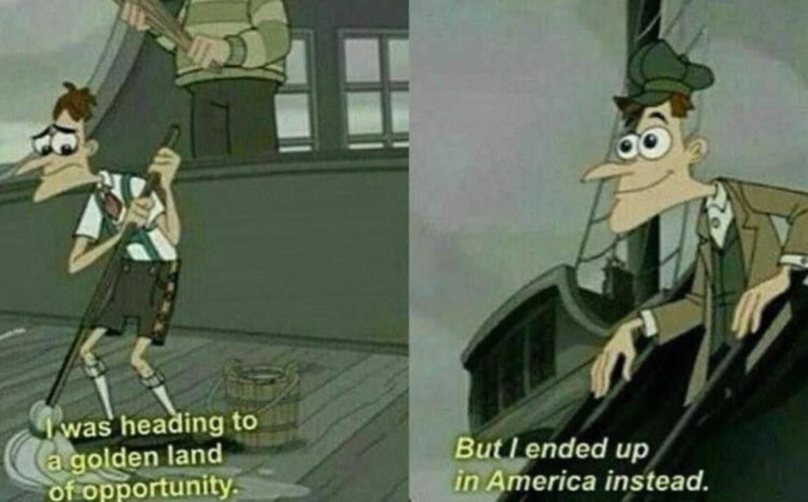
Thank you for your attention!

Slide 8
References
Alfonso Durbán, M. (2017). Interpreting Accents: An analysis of the cognitive process of interpreting the Scottish accent taking a phonological approach. [Master's Thesis, Universitat Autònoma de Barcelona]. Retrieved from https://www.semanticscholar.org/paper/Interpreting-Accents-%3AAn-analysis-of-the-cognitive-Durb%C3%A1n/5db1baa294cffcac4e4a970dbdd7913158d65d9e
Azad, S. B. (2009). Lights, Camera, Accent: Examining Dialect Performance in Recent Children's Animated Films. [Master's Thesis, Georgetown University]. Retrieved from http://hdl.handle.net/10822/553140
Dobrow, J. R., & Gidney, C. L. ( 1998). The Good, the Bad, and the Foreign: The Use of Dialect in Children's Animated. The Annals of the American Academy of Political and Social Science , 557, 105-119. Retrieved from http://www.jstor.com/stable/1049446
Hepburn, A. & Bolden, Galina (2013). The Conversation Analytic Approach to Transcription. The Handbook of Conversation Analysis, 57-76.
Hodson, J. (2014). Dialect in Film and Literature. New York: Palgrave Macmillan. Hughes, R., Povenmire, D., & Marsh, J. (Directors). (2007-2015). Phineas and Ferb [Motion Picture].
Lippi-Green, R. (2012). English with an Accent  Language, Ideology, and Discrimination in the United States. Abingdon: Routledge.
Reinacher, L. (2016). Discrimination in a Land Far, Far Away Stereotyped Dialects in Animated Children’s Films. [Masterarbeit, Christian-Albrechts-Universität zu Kiel]. Retrieved from https://www.anglistik.uni-kiel.de/de/fachgebiete/kultur-und-medienwissenschaften/popularculture/materialien/animated-children2019s-films
Rosa, J. (2006). Discourse, Linguistic Production, and Subjectivity: Disney-fying Language. Taboo: The Journal of Culture and Education, 10(2), 109-140. doi: https://doi.org/10.31390/taboo.10.2.14
Soares, T. O. (2017). Animated Films and Linguistic Stereotypes: A Critical Discourse Analysis of Accent Use in Disney Animated Films. BSU Master Theses and Projects (Item 53). Retrieved from http://vc.bridgew.edu/theses/53
Wallace, D. (2008). Hyperrealizing "Borat" with the Map of the European "Other". Slavic Review, 67(1), 35-49. Retrieved from http://www.jstor.com/stable/27652765
Wiedlack, K. (2019). In/visibly different: Melania Trump and the othering of Eastern European women in US culture. Feminist Media Studies, 19(8), 1063-1078. Retrieved from https://doi.org/10.1080/14680777.2018.1546205

