Slide 1
On Cognate Objects in Norwegian: An Empirical Approach
Bachelor’s thesis in linguistics (10 ECTS)
Spring 2021, University of Oslo
By Solveig Sofie Øvrewall Berntzen
ssberntz@student.iln.uio.no

Slide 2
Content
1 Introduction
2 Method
3 Which Verbs Can Take Cognate Objects?
3.1 Unaccusative Verbs
3.2 Unergative Verbs
4 Do Cognate Objects Require Modification?
4.1 Modified versus Non-Modified Cognate Objects
4.2 Towards an Explanation
4.3 Modifiers
5 Are Cognate Objects Arguments or Adjuncts?
5.1 Diagnostics
6 Conclusion
7 References

Slide 3
1 Introduction
An empirical analysis of cognate objects (henceforth COs) in Norwegian
Cognate objects are noun phrases whose head noun is semantically and often morphologically related (i.e., ‘cognate’) to the verb (Faarlund et al. 1997:665), as illustrated in (1a-c):
(1) a. Hun sov [en urolig søvn]. b. Han løp [sitt beste løp] noensinne. c. De lever [et hundeliv]. she slept a restless sleep he he ran his best run ever they live a dog’s.life ‘She slept a restless sleep.’ ‘He ran his best run.’ ‘They live a dog’s life.’
Most COs are derived by non-zero affixation (Pereltsvaig 2002:107), as in (1b), or the head is part of a complex compound, as in (1c). Moreover, COs are usually modified by one or several elements, such as an adjective (1a-b), as possessive (1b), and/or the first part of a compound (1c).
COs are taken to be resultant objects «whose referents are produced by the actions represented by the verbs» (Kuno & Takami 2004:119). Faarlund et al. (1997:718) use the term “effected/product object”.

Slide 4
1 Introduction
Cross-linguistically, COs have been subject of a lot of research throughout the last decades (e.g., Perlmutter 1978, Pereltsvaig 2002, Kuno & Takami 2004), but a separate (corpus-based) study for Norwegian is yet to be done. Thus, the goal of this thesis is to shed new light on COs in Norwegian and by that contribute to our general understanding of cognate object constructions in human languages.
The following research questions (2) form an important part of previous studies on COs (e.g., for Hebrew, see Pereltsvaig 2002; for English, see Nakajima 2006; for Sason Arabic, see Akkuş & Öztürk 2017).
(2) In Norwegian, a. which verbs can appear in cognate object constructions? b. do cognate object require modification? c. are cognate objects arguments (i.e., direct objects) or adjuncts (i.e., adverbial)?

Slide 5
2 Method: Questions (2a-b)
Norwegian Web as Corpus (NoWaC), a web-based corpus of Bokmål Norwegian containing about 700 million tokens (Guevara 2010)
How are COs and modifiers used and to what extent (i.e., frequencies)?
Search criteria:
(3) ELEMENT 1: verb [lemma] [max. 3] ELEMENT 2: cognate object [lemma/end]
A samle of constructions (matches) are annotated to eliminate false positives and duplicates (annotation criteria TBA).

Slide 6
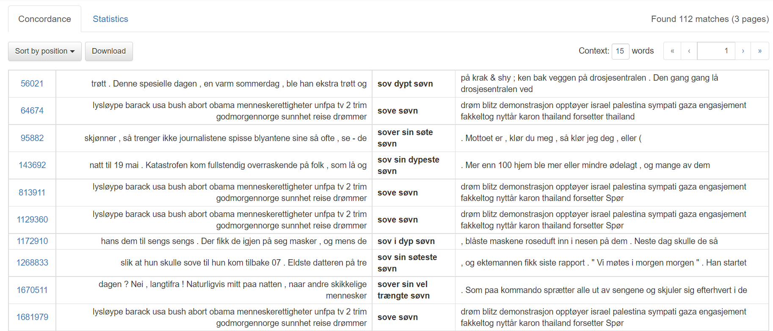
2 Method: Questions (2a-b)

Slide 7
2 Method: Question (2c)
Which properties do COs share with arguments and adjuncts (i.e., how do they “behave” syntactically)?
Three diagnostics:
[i] Coordination [ii] Pronominalization [iii] Question formation

Slide 8
3 Which Verbs Can Take Cognate Objects?
In other words: Are cognate objects restricted to unergatives (as opposed to unaccusatives)?
The Unergative Restriction on the Cognate Object Construction: «Only unergative verbs can appear in the cognate object construction. No unaccusative verbs can.» (Kuno & Takami 2004:107)
Originally defined by Perlmutter (1978)
Unergative predicates describe willed or volitional acts (e.g., play, bark), and involuntary bodily processes (e.g., sneeze, sleep). They take a semantic Agent or Experiencer as their subject.
Unaccusative predicates are (roughly speaking) predicates whose subjects are Themes or Patients (e.g., burn, fall), predicates of existing and happening (e.g., occur, end up), and aspectual predicates (e.g., begin, stop).
NB: Transitivity alternations. This analysis includes all verbs that [i] can be used intransitively, and [ii] that can take a se-mantically and morphologically related object. The corpus searches and classification of verbs into verb classes are primarily (but not exclusively) based on translations of the English counterparts in Perlmutter (1978:162-163) and Levin (1993:95).

Slide 9
3.1 Unaccusative Verbs
TABLE 1: Total number of attested unaccusative verbs that can take COs in NoWaC, with their absolute and relative frequency. All data are annotated.

Slide 10
3.1 Unaccusative Verbs
(4) a. […] og de dør [en grusom sultedød]. and they die a gruesome death.from.starvation ‘and they die a gruesome death from starvation.’ (NoWaC, sentence ID 34517605) b. Han faller [det fallet vi gjerne kaller pladask]. he falls that fall we usually call smack ‘He falls that fall we usually call smack.’ (NoWaC, sentence ID 6774596) c. Skal åpne [den ene åpningen på toppen] slik at det kommer luft ned til dem. shall open the one opening on top.the so that it comes air down to them ‘Shall open the one opening on the top so that air comes down to them.’ (NoWaC, sentence ID 25279886)

Slide 11
3.2 Unergative Verbs
Out of 36 predicates that can take COs in NoWaC (including unaccusatives), as much as 33 verbs are unergative, with a total of 30 736 unannotated constructions (i.e., prior to elimination of false positives and duplicates).
Three main groups (based on Levin 1993):
[i] Verbs of non-verbal expression (379 matches; 1.23%): glise ‘grin’, gråte ‘cry’, le ‘laugh’, nyte ‘sneeze’, smile ‘smile’, sukke ‘sigh’ [ii] Manner of speaking verbs (3334 matches; 10.85%): bjeffe ‘bark’, brøle ‘roar’, buldre ‘rumble’, hyle ‘howl’, pludre ‘jabber’, prate ‘chatter’, rope ‘shout’, skrike ‘scream’, snakke ‘talk’, synge ‘sing’ [iii] Various verbs (27 023 matches; 87.92%): be ‘pray’, danse ‘dance’, drikke ‘drink’, drømme ‘dream’, grave ‘dig’, hoppe ‘jump’, kjempe ‘fight’, leke ‘play’, leve ‘live’, løpe ‘run’, prompe ‘fart’, skrive ‘write’, sove ‘sleep’, spille ‘play’, spinne ‘spin’, spørre ‘ask’, tenke ‘think’
Accordingly, the above findings largely confirm the Unergative Restriction in that most Norwegian COs combine with unergatives, with dø ‘die’ being the main exception.

Slide 12
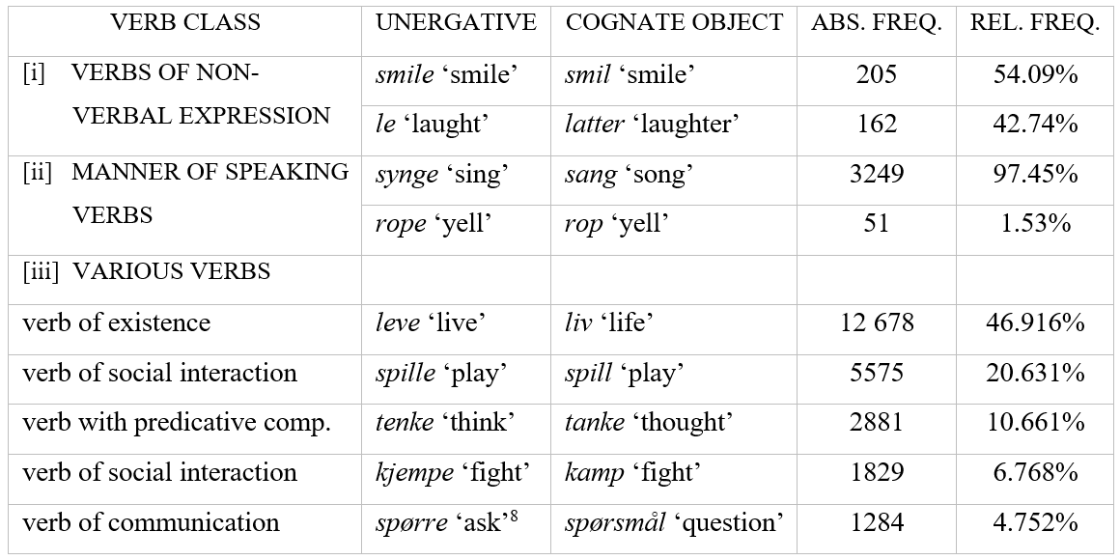
TABLE 2: The most frequent unergative verbs that can take COs in NoWaC, with their absolute and relative frequency of the total sum of matches within each class. This data is not annotated.

Slide 13
4 Do Cognate Objects Require Modification?
Annotating twelve randomly selected COs (TBA)
A brief overview of the annotation criteria (i.e., various types of modifiers), classified by form and parts of speech (Faarlund et al. 1997:27-30):
ADJECTIVES (‘ADJ’): [i] heads of adjective phrases (e.g., en veldig fin sang ‘a very nice song’), [ii] ordinal numbers (hans andre løp ‘his second run’), and [iii] the determinative egen ‘own’ (e.g., mitt eget liv ‘my own life’)
POSSESSIVES (‘POSS’): [i] possessive pronouns (e.g., min ‘my’, hans ‘his’), and [ii] possessive determiner phrases (e.g., verdens største smil ‘the world’s biggest smile’)
DEMONSTRATIVES (‘DEM’): expressing definiteness, proximity or distance (e.g., denne ‘this’, den ‘that’, slik ‘such’)
QUANTIFIERS (‘QUANT’): e.g., alle ‘all’, noen ‘some’, fem ‘five’, samtlige ‘all’, ingen ‘no’, et par ‘a couple’, mange ‘many’

Slide 14
4 Do Cognate Objects Require Modification?
PREPOSITIONAL PHRASES (‘PP’): serve as adjuncts to the head noun. This criterion is not used when the PP is ambigious as to what it modifies – the CO or the verb. E.g., Han drømmer en drøm [om håp] ‘he dreams a dream about hope’, where the PP can attach at the NP- or VP-level.
APPOSITIONS (‘APP’): the last part of more complex noun phrases, which specifies the reference of the CO (e.g., folkedansen Dapka ‘the folk dance Dapka’)
RELATIVE CLAUSES (‘REL’): [i] subordinate relative clauses (den sangen [jeg liker] ‘that song I like’), and [ii] reduced relative clauses (et smil [fylt av kjærlighet] ‘a smile filled with love’) (Sag 1997:39)
COMPOUNDS (‘COMP’): endocentric, with the head (i.e., the CO) to the right. Hence, the CO determines what part of speech the compound belongs to, and the left constituent modifies the meaning of the CO (e.g., folkedans ‘folke dance’, sottedød ‘death from disease’, kjempeløp ‘huge run’).

Slide 15
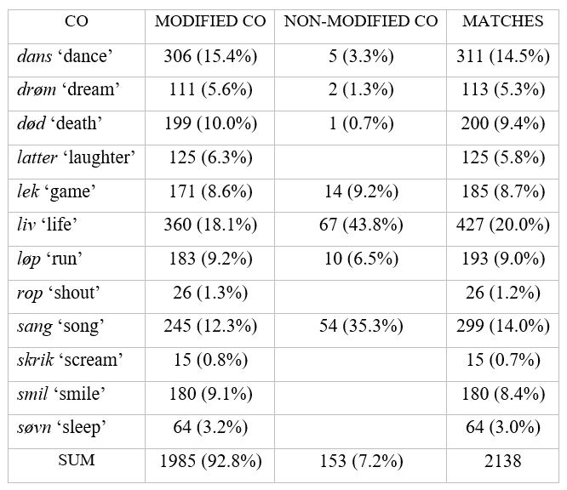
TABLE 3: An overview of twelve randomly selected COs in NoWaC, each with its total number of modified and non-modified matches. In cases where there are over a thousand hits for one search, I have annotated a random selection of 500 constructions. Relative frequencies are given within parentheses: of the total number of modified COs in column 2, of the total number of non-modified COs in column 3, and of the total number of annotated matches in column 4.

Slide 16
4.1 Modified vs. Non-Modified COs
Generalization: The modification requirement of COs in Norwegian largely depends upon the verbs’ valency.
A. Modification seems to be required for COs of verbs that can only take objects to which they are morphologically and semantically related, as indicated with an asterisk:
(5) a. Hun døde [en *(tragisk) død]. ‘She died [a tragic death].’ b. Jeg ler [en *(trillende) latter]. ‘I laugh [a rippling laughter].’ c. Hun smiler [et *(bredt) smil]. ‘She smiles [a broad smile].’ d. Han sover [en *(dyp) søvn]. ‘He sleeps [a deep sleep].’
B. Non-modified COs attach to more transitive-like verbs that can take a wider range of objects. Hence, modification seems to be optional for COs of verbs that can take both cognate and non-cognate objects:
(6) a. De danser {en (rolig) dans / en vals}. ‘They dance {a (calm) dance / a valse}.’ b. Jeg drømmer {en (skummel) drøm / at jeg kan fly}. ‘I dream {a (scary) dream / that I can fly}.’

Slide 17
4.1 Modified vs. Non-Modified COs
c. Vi leker {en (morsom) lek / sisten}. ‘We play {a (fun) game / tag}.’ d. Han lever {et (aktivt) liv / drømmen}. ‘He lives {an (active) life / the dream}.’ e. Hun løper {et (sterkt) løp / maraton}. ‘She runs {a (strong) run / a marathon}.’ f. Barna synger {en (nydelig) sang / et vers}. ‘The children sing {a (beautiful) song / a verse}.’
c. There are two exceptions: rop ‘shout’ and skrik ‘scream’ seem to require modiciation even though their predicates allow non-cognate objects. They thus behave like død ‘death’, latter ‘laughter’, smil ‘smile’, and søvn ‘sleep’ (Group A) in that modification is required:
(7) a. Hun ropte {*(sinte) rop / farvel}. ‘She shouted {angry shouts / farewell}.’ b. Jeg skrek {et *(kort) skrik / at jeg skulle dra}. ‘I screamed {a short scream / that I was going to leave}.’

Slide 18
4.2 Towards an Explanation
Pragmatic redundancy: The object of an intransitive verb must be modified by an element that «makes a contribution to the meaning of the sentence» (Levin 1993:96).
The verb le ‘laugh’ (8a) can only take an object to which it is morphologically and semantically related (Group A), but the object itself does not provide any new information on its own. Hence, modification is required.
The verb spille ‘play’ can also take non-cognate objects (Group B), such as musikk ‘music’ or teater ‘theater’. Its object in (8b) thus has a more restricted meaning in that it “delimits” the number of possible actions denoted by the verb. Hence, modification is optional.
(8) a. Hun lo [en *(trillende) latter]. b. hele julen gikk med til å spille [(morsomme) spill] she laughed a rippling laughter whole Christmas.the went on by to play fun games ‘She laughed a rippling laughter.’ ‘The whole Christmas was spent playing (fun) games.’ (Faarlund et al. 1997:718)

Slide 19
4.2 Towards an Explanation
The same redundancy applies to parasynthetic compounds like brown-eyed (brunøyd in Norwegian). Nevins & Myler (2014) argue that eyed is technically grammatical, but uninformative when it is non-modified. Compare (8a) to (9a-c):
(9) a. en *(brun)øyd jente ‘a *(brown-)eyed girl’ b. en *(en)armet mann ‘a *(one-)armed man’ c. en *(rød)håret kvinne ‘a *(red-)haired woman’

Slide 20
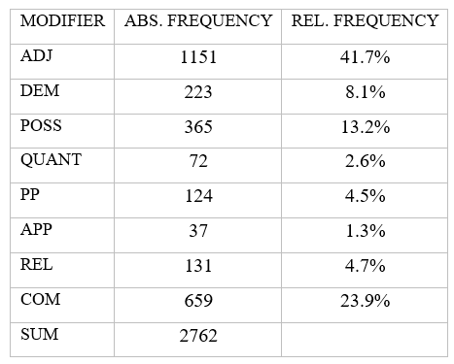
4.3 Modifiers
Most frequent modifier for Group A and drøm ‘dream’ and liv ‘life’
TABLE 4: Absolute and relative frequency of each modifier.
Most frequent modifier for Group B and C

Slide 21
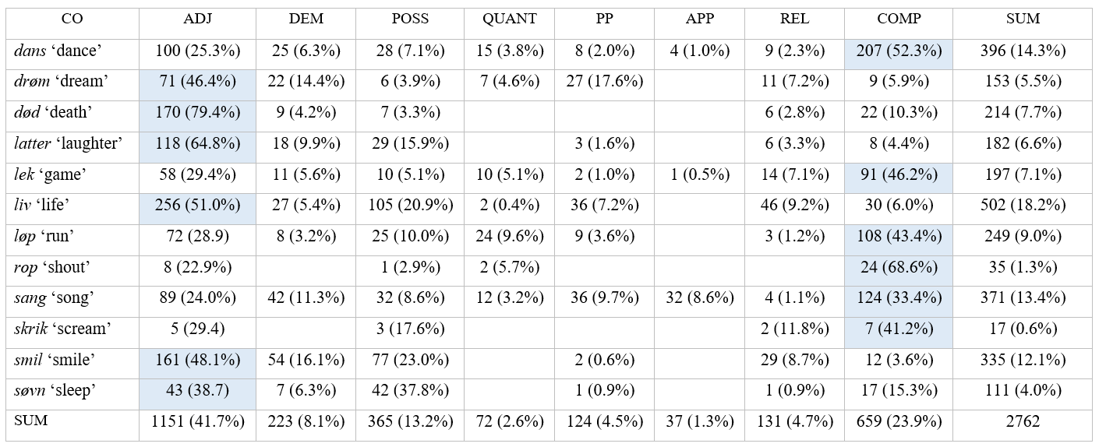
TABLE 5: Total number of modifiers for each CO, with the most frequent one marked in blue. One CO can be modified by several elements. Percentages of the total sum of modifiers for each CO are given in parentheses. In the rightmost coloumn and the buttom row (both marked “SUM”), percentages of the total sum (2761) are given. E.g., there are 396 modifiers in total for dans ‘dance’, of which compounds are most frequent (52.3%). The total number of modifiers for dans constitutes 14.3% of the total amount of modifiers altogether (2762). There are 1151 adjectives in total, which amount to 41.7% of all modifiers.

Slide 22
5 Are COs Arguments or Adjuncts?
How do Norwegian COs “behave” syntactically?
(10) a. Karen brølte [at hun ville dra]. (= at-clause) Hypothesis 1: COs are arguments Karen roared that she wanted to.leave (daughter of V’, sister to V) ‘Karen roared that she wanted to leave.’ b. Løvene brølte [hele natten]. (= temporal adverbial) Hypothesis 2: COs are adjuncts the.lions roared all night (daughter of V’, sister to V’) ‘The lions roared all night long.’
The Unaccusative Hypothesis: «Unergative and unaccusative verbs are syntactically differentiated; while unergative verbs have nonderived subjects (i.e., surface subjects are generated as subjects at D-structure), surface subjects of unaccusative verbs originate as direct objects.» (Kuno & Takami 2004:19)

Slide 23
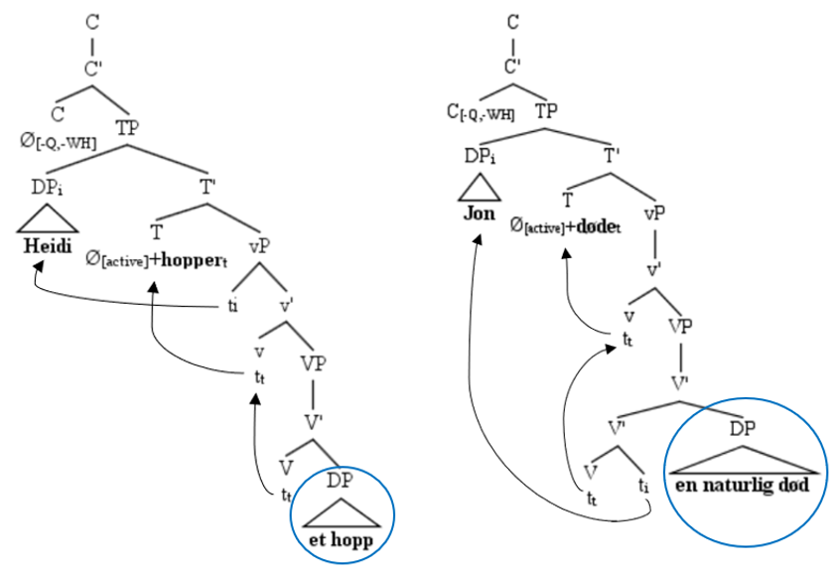
(11) a. Unergative
Heidi hopper [et langt hopp].
‘Heidi jumps a long jump.’ b. Unaccusative Jon døde [en naturlig død]. ‘Jon died a natural death.’
Drawn with TreeForm (Derrick & Archambault 2010)
Argument position
Adjunct position

Slide 24
5.1 Diagnostics
Coordination: Only constituents that are «of the same syntactic category and/or have the same semantic function» (Akkuş & Öztürk 2017:5) can be conjoined. In Norwegian, most COs can appear in coordination with other objects, but not with adverbs (12a). The object of le ‘laugh’, smile ‘smile’, sove ‘sleep’, and unaccusative dø ‘die’ (Group A) cannot be combined with neither arguments nor adjuncts (12b).
(12) a. Unergative + CO + {object / adverb} Vi danset [en tradisjonell dans] og {ballett / *hele kvelden}. we danced a traditional dance and ballet whole night.the ‘We danced a traditional dance and {ballet / the whole night}.’ b. Unaccusative + CO + {object / adverb} Jon døde [en naturlig død] og {*ende på livet / *uten smerte}. Jon died a natural death and end of life without pain ‘Jon died a natural death and {end of life / without pain}.’

Slide 25
5.2 Diagnostics
Pronominalization: Only COs of more transitive-like verbs (Group B and C) can undergo it-pronominalization in Norwegian (12a). As in English, død ‘death’, smil ‘smile’ (14b), latter ‘laughter’, and søvn ‘søvn’ (Group A) cannot, or are at the very least ambiguous (Kuno & Takami 2004:132), except for the CO of unaccusative dø ‘die’.
(12) a. Barna lekte [en morsom lek]_{i}. De lekte den_{i} kun om sommeren. children.the played a fun game they played it only during summer.the ‘The children played a fun game. They played it only during the summer.’ b. Heidi smiler [et bredt smil]_{i}. ?/*Hun smiler det_{i} alltid når hun er glad. Heidi smiles a broad smile she smiles it always when she is happy ‘Heidi smiles a broad smile. She always smiles it when she is happy.’

Slide 26
5.2 Diagnostics
Question formation: In Norwegian, objects are questioned with wh-words such as hvilken/hvilket ‘what/which’ and hva slags ‘what kind of’, similar to English (Nakajima 2006:677), whereas hvordan ‘how’, hvorfor ‘why’, hvor ‘where’, and the like are used to question adverbials. All of the selected COs seem to be compatible with hvilken/hvilken and hva slags (14a-b), which strengthens Hypothesis 1.
(14) a. Q: {Hvilket / Hva slags / *Hvordan} løp løper hun? A: Et {(langt) løp (på mange mil) / maratonløp} what what kind how run runs she? a long run of many miles marathon ‘{What / What kind of / How} run does she run? ‘A {(long) run (of many miles) / marathon}.’ b. Q: {?Hvilken / Hva slags / *Hvordan} død døde han? A: En *(naturlig) død. what what kind how death died he a natural death ‘{What / What kind of / How} death did he die? ‘A natural death.’

Slide 27
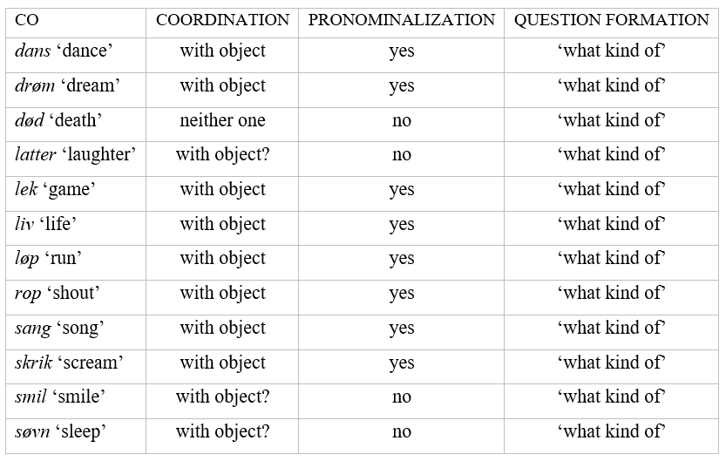
TABLE 6: An overview of how each test applies to a random selection of COs in Norwegian.

Slide 28
6 Conclusion
Both unaccusative and unergative verbs can take cognate objects, although unergatives are by far most frequent.
The modification requirement largely depends upon the verbs that COs combine with and the verbs’ valency. If the verb cannot take non-cognate objects, the CO needs to be modified in order to avoid redundancy. Modification is (with few exceptions) optional for COs of more transitive-like verbs that can take non-cognate objects as well, presumably because the object delimits the number of possible actions denoted by the verb (its “scope”).
COs appear to be argumental. In general, they behave like direct objects in that they can only be coordinated with other objects, that the majority can undergo it-pronominalized, and that they can be questioned by interrogatives such as hvilken/ hvilket ‘what/which’ and hva slags ‘what kind of’. However, the objects of Group A appear to be more adverbial in nature.

Slide 29
7 References
Akkuş, Faruk, and Balkız Öztürk. 2017. On cognate objects in Sason Arabic. In Proceeding of the 40th Annual Penn Linguistics Conference 23(1), 1–10. Booij, Geert. 2012. The Grammar of Words: An Introduction to Linguistic Morphology. Third edition. New York: Oxford University Press. Carnie, Andrew. 2013. Syntax: A Generative Introduction. Third edition. Oxford: Wiley-Blackwell. Derrick, Donald, and Daniel Archambault. 2010. TreeForm: Explaining and exploring grammar through syntax trees. Literary and Linguistic Computing 25(1):53–66. Dowty, David R. 1979. Word Meaning and Montague Grammar: The Semantics of Verbs and Times in Generative Semantics and in Montague’s PTQ. Dordrecht: Kluwer Academic Publishers. Faarlund, Jan Terje, Lie, Svein, and Kjell I. Vannebo. 1997. Norsk referansegrammatikk. Oslo: Universitetsforlaget. Guevara, Emiliano R. 2010. NoWaC: a large web-based corpus for Norwegian. In Proceedings of the NAACL HLT 2010 Sixth Web as Corpus Workshop, Association for Computational Linguistics, 1–7. http://www.hf.uio.no/iln/om/organisasjon/tekstlab/prosjekter/nowac/index.html

Slide 30
7 References
Kuno, Susumu, and Ken-ichi Takami. 2004. Functional Constraints in Grammar: On the Unergative-Unaccusative Distinction. Amsterdam/Philadelphia: John Benjamins Publishing Company. Levin, Beth. 1993. English Verb Classes and Alternations: A Preliminary Investigation. Chicago/London: The University of Chicago Press. Nakajima, Heizo. 2006. Adverbial cognate objects. Linguistic Inquiry 37(4):674–684. Nevins, Andrew, and Neil Myler. 2014. A brown-eyed girl. UCLA Working Papers in Linguistics 18:243–257. Pereltsvaig, A. 2002. Cognate objects in Modern and Biblical Hebrew. In Themes in Arabic and Hebrew Syntax, ed. by Jamal Ouhalla and Ur Shlonsky, 107–136. Dordrecht: Kluwer Academic Publishers. Perlmutter, David M. 1978. Impersonal passives and the unaccusative hypothesis. In Proceedings of the Annual Meeting of the Berkeley Linguistics Society 38(4), 157–189. Sag, Ivan A. 1997. English relative clause constructions. Journal of Linguistics 33:1–54.

Slide 31
7 References
Språkrådet. No year. Spørre spørsmål? Updated 01.05.21. https://www.sprakradet.no/svardatabase/sporsmal-og-svar/sporre-sporsmal/ Vendler, Zeno. 1968. Linguistics in Philosophy. Ithaca: Cornell University Press.

