Slide 1
CRISIS COMMUNICATION & CRISIS MANAGEMENT DURING COVID 19: A CASE STUDY
Em. Professor Ruth Wodak, FAcSS
Distinguished Professor and Chair of Discourse Studies
Lancaster University/University Vienna
r.wodak@lancaster.ac.uk
http://www.ling.lancs.ac.uk/profiles/265

Slide 2
“‘Fear’ is the name that we give to our uncertainty: to our ignorance of the threat and what is to be done - what can and what can’t be - to stop it in its tracks - or to fight it back if stopping it is beyond our power.” (Zygmunt Bauman Liquid Fear 2006, p. 2)
“It is in the nature of a crisis that a decision is due but not yet taken. The general uncertainty in a critical situation is thus pervaded by the certainty that - uncertain when, but certain, uncertain how, but certain - an end to the critical state is imminent.” (Reinhart Koselleck Kritik und Krise 1973, p. 105).

Slide 3
OUTLINE
COVID-19 – a game changer?
Defining Crisis(communication)
Critical Discourse Studies
Defining “Discourse Studies“
Discourse, Text, Genre, Frames
Legitimation Strategies
Framing Crisis Communication: Coping with the “Dread of Death“
Examples (Austria, France, Germany, Hungary, Sweden, New Zealand)
COVID-deniers – conspiracy theories
Results, Perspectives and Alternatives

Slide 4
COVID-19 and political communication
Change seems equally dramatic
Healthcare suddenly issue number 1, bringing little known experts to the foreground
Message control: press conferences, speeches, announcements at a bewildering rate
Only some of the far-right populists deny the severity of the crisis or see a conspiracy
New expert discourse in political discourse (and mediatized politics)
New knowledge
New vocabulary
New arguments and logics

Slide 5
CRISES ARE
Leitfaden Krisenkommunikation, Berlin: BMI, p.5
Open-ended
Not controllable
Limited in time
Dynamic
no clear trajectory
Frequently very complex
Crises are of high interest for media and citizens
Crises could damage reputation
Crises visibilize bad management
Unpredicatablesurprising
Threatening important assets
Unique situation
In scope and consequences hardly mangeable
“Effective“ Crisis-Communication: Dialogic Orientation, Truthfulness, Transparency, Trustworthiness

Slide 6
Do existing theories and concepts still apply? Have ongoing trends been interrupted or intensified?
Politics of fear and hope
Has a new type of politics emerged, focused on contents (Sachpolitik)?
Nationalism / re-nationalization
How has Covid-19 affected – or been instrumentalized for – ongoing trends of re-nationalization and populism?
Securitization
Has there been a securitization of Covid-related discourses, paralleling the securitization of (im)migration, especially in terms of restricting civil liberties/human rights?
Operationalized in terms of specific discursive strategies : Which old/new discursive strategies are being used in the above contexts?

Slide 7
Critical Discourse Studies
The Discourse-Historical Approach:
Discourse, text, genre, context

Slide 8
Discourses – power struggles over words/meanings
Discourses comprise context-dependent argumentation schemes and legitimation strategies that support claims, decisions, ideologies…
Discourses are polyphonic – different agents endorse different positions
Discourses manifest power struggles over positions, sometimes condensed in single/specific words
Discourses are historical – always linked with other discourses (interdiscursivity) and other texts (intertextuality)
Discourses comprise the recontextualisation (resemiotisation) of concepts across backstage & frontstage, genres, and time.

Slide 9
DISCOURSE, GENRE & TEXT
Discourse implies patterns and commonalities of knowledge and structures;
Text is a specific and unique realization of a discourse. Texts belong to “genres”.
‘Genre’ characterised as ‘a socially ratified way of using language in connection with a particular type of social activity’ (Fairclough 1995: 14), used by ‘communities of practice’ with specific ‘functions’ (Swales 1992).
Text creates sense when its manifest and latent meanings are read in connection with knowledge of the world (‘context models’, ‘shared knowledge’, ‘collective memories’, ‘resonance’)

Slide 10
Adopted from Reisigl & Wodak 2016: 30
Notes:
And let me just add that the notion of genre mentioned here is defined by Fairclough, another key figure in CDS, as ‘a socially ratified way of using language in connection with a particular type of social activity’. For example, a tweet or news article belong to different genres.
---
We have defined discourse, we have heard about semiotic practices or texts (written, spoke, images, aso.), we have heard about topics, and we have heard about intertextual and interdiscursive relations.

Slide 11
4-Level Context-Modell
‘Discourses are always connected to other discourses which were produced earlier, as well as to those which are produced synchronically or subsequently.’ (Wodak 1996, 19)
The DHA’s context model (Reisigl & Wodak 2016, 30f):
Co-text and co-discourse
Intertextual and interdiscursive relationships
Specific ‘context of situation’
Socio-political/historical context
Notes:
However, both the semiotic practices and discourses as a whole can only be understood against the background of other discourses.
As Wodak says: ‘Discourses are always connected to other discourses which were produced earlier, as well as to those which are produced synchronically or subsequently.’
This is because the HISTORICAL in DHA does not mean that the approach focuses primarily on things in the past, on history. Rather, it means that we need to consider intertextual and interdiscursive connections across time and space to understand meaning-making.
That is why interdisciplinary is crucial in the DHA: we have to draw on knowledge provided by historians, sociologists, political scientists and others to understand context so to ultimately understand the meaning of an utterance.
Therefore, the DHA proposes a four dimensional context model:
First, the immediate, language or text-internal co-text and co-discourse
Second ,intertextual and interdiscursive relationships between texts
Third, the extralinguistic social variables and institutional frames of the specific ‘context of situation’
And fourth, the broader socio-political/historical context
---

Slide 12
FRAMING CRISIS-COMMUNICATION- COPING WITH THE “DREAD OF DEATH“

Slide 13
FRAMES
Frames serve as ‘interpretation frameworks’, as worldviews or as ‘cultural worldviews’ (Fillmore, Goffman, Cicourel, Lakoff, Entman….)
The function of ‘interpretation frameworks’ for text comprehension is to convey elements of meaning that can be invoked by speakers and writers as self-evident.
Such presuppositions and expectations are picked up by the respective audience; statements are then invested with their complete meaning (“dialogicity“; Bahktin):

Slide 14
Analyzing Crisis -Communication (3/2020 - 6/2020)
Religious frame: Discursive construction of a saviour or of a “strict father”
Dialogic frame: explanation of measures, discursive construction of caring father/mother
War-frame: National war against the virus, militarisation and securitization of everyday life
Trust frame: building on trust of people to government and institutions allows cost-benefit argumentation
(Austrian, German, French, Hungarian, Swedish, Italian, Greek and New Zealand data: government speeches, press agency reports and press conferences)
(Ruth Wodak [2021] Crisis Communication and Crisis Management during COVID Global Discourse; https://doi.org/10.1332/204378921X16100431230102
Ruth Wodak [2020] Krisenkommunikation in “Corona-Zeiten” In: Th. Schmidinger/J. Weidenholzer (Hg.) Virenregime. Wien.)

Slide 15
EXAMPLES
“Easter week will be a decisive week for us. It will be a week that will determine whether the resurrection after Easter that we all wish for can take place“ (Kurz, ZIB Spezial, 6 April 2020)
“Our Easter is taking place under special circumstances this year. … The measures being taken demanded a lot from us but were necessary to prevent the worst. Four out of five people infected with Corona have no symptoms and therefore do not know that they are ill. This is one reason why the virus is so dangerous for our society. … Next year at Easter, we want to be able to look back together and say, ‘good that we defeated the Coronavirus“. (Kurz, ZIB, 6.4. 2020).
Before I explain in detail the expanded guidelines […], I would like to directly address all of those who are currently adhering to the necessary behavioral regulations. I thank you. […] I am very moved that so many people have adhered to these behavioral regulations. We have thus demonstrated our commitment to the elderly and those with prior illnesses, for whom the virus is most dangerous. Put simply: We are thereby saving lives.” (Angela Merkel, 22.3. 2020)
The restrictions of personal/individual liberties are “an imposition on democracy” (Angela Merkel, 23.4.2020).

Slide 16
“I understand that all of this rapid change creates anxiety, and uncertainty. Especially when it means changing how we live. That’s why today I am going to set out for you as clearly as possible, what you can expect as we continue to fight the virus together .” (Jacinda Ardern, 21.3.2020)
“There has been some interest internationally in our approach to combat the virus. […] Our welfare state is universal, including the health care system. It is publicly funded and accessible to all. … There is a tradition of mutual trust between public authorities and citizens. People trust and follow the recommendations of the authorities to a large extent.” (Lena Hallengren, 23. 4.2020).
“[Our strategy] is built upon information and providing the population with knowledge [...] the success factors of our disease prevention is built on trust and faith” (Johan Carlson, 20.3.2020).
“Nous sommes en guerre et face à ce qui se profile, ce pic de l'épidémie qui est devant nous, j'ai décidé, sur proposition de la ministre des Armées et du chef d'état-major des Armées, de lancer l'opération Résilience.“ (Emanuel Macron, 25.3. 2020)
That is why we […] declared the state of emergency. The state of emergency means that the government has been given the authority and the means to organize Hungary's self-defense with a chance of success. […]” (Viktor Orbán, 30.3.2020)

Slide 17
LEGITIMATION STRATEGIES
LEGITIMATION VIA AUTHORITY
LEGITIMATION VIA RATIONALISIATION
LEGITIMATION VIA MORALISATION
LEGITIMATION VIA “MYTHOPOESIS”
(Theo van Leeuwen/ Ruth Wodak [1999] ‘Legitimizing immigration control: A discourse-historical analysis’, Discourse Studies, 1(1): 83–118; Ruth Wodak [2018] ‘“Strangers in Europe”: A discourse-historical approach to the legitimation of immigration control 2015/16’, in S. Zhao. et al. (eds.), Advancing Multimodal and Critical Discourse Studies. London, pp. 31–50.)

Slide 18
COVID-DENIAL CONSPIRACY THEORIES

Slide 19
Defining Scapegoats/ Creating ‘Enemy Images‘ (Feindbild)
‘Specific form of a negative stereotype‘ (Oppenheimer, L. (2006) The Development of Enemy Images Peace and Conflict. J Peace Psychology 12/3: 271)
‘Reservoirs of permanent externalization‘ (Volkan, V. (2013) ‘Large Group Identity, international relations, and psychoanalysis’ Int. Forum Psychoanalysis 18/4: 216)
‘The collective violence towards the hostile group is justified through specific psychological delegitimization processes‘ (Zamperini, A. et al. (2012) The Deconstruction of Enemy Images for a Nonkilling Society. In Christie, D. et al. (Eds.) Nonkilling Psychology. Honolulu: Creative Commons, p. 330)
Shifting blame for complex problems on scape-goat; simple “rescue“ narrative

Slide 20
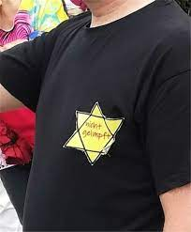
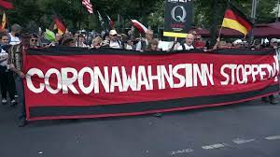
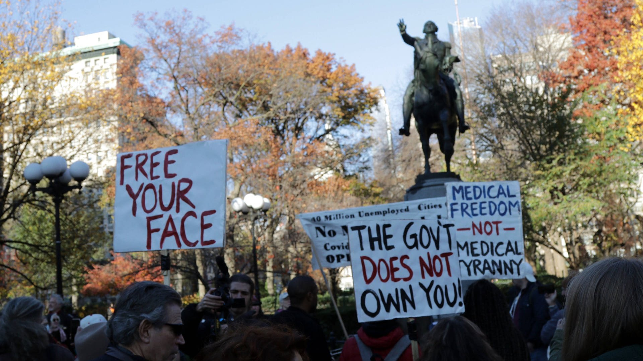
CONSPIRACY THEORIES, FALLACIOUS ANALOGIES, FAR-RIGHT INSTRUMENTALISATION OF PROTESTS
https://www.woxx.lu/antisemitismus-corona-ein-gefundenes-fressen/
https://www.daserste.de/information/wissen-kultur/ttt/videosextern/die-corona-leugner-und-die-demokratie-100.html
https://www.swr.de/swr2/wissen/die-grosse-luege-corona-leugner-in-den-usa-100.html

Slide 21
6 Strategies of the Infodemic during the Pandemic
Relevant measures are delegitimized (waering of masks, etc.)
Propagating bad medication
Relativize danger
Total denial of the existence of COVID, of the pandemic
Selling wrong protection on-line
Creating scape goats
(Hansson, S., Orru, K., Torpan, S., B.ck, A., Kazemekaityte, A., Meyer, S.F., Ludvigsen, J., Savadori, L., Galvagni, A., & Pigr.e, A. (2021). COVID-19 information disorder: Six types of harmful information during the pandemic in Europe J of Risk Research https://doi.org/10.1080/13669877.2020.1871058)

Slide 22
RESULTS, PERSPECTIVES, AND ALTERNATIVES

Slide 23
Results: Challenges and Dangers
Re/Nationalisation
Conspiracy theories and scapegoating
Exclusion of vulnerable groups; generation conflict
Rise of authoritarianism (“Message-Control”)
Instrumentalisation of discontent
Normalisation of restrictions – “Crisis of Human rights”
(Jürgen Habermas/Klaus Günther (2020) Kein Grundrecht gilt grenzenlos Zeit Online 6. May 2020; Human Rights Dimensions of COVID-19 Response, 19 March 2020 (https://www.hrw.org/news/2020/03/19/human-rights-dimensions-covid-19-response)

Slide 24
Perspectives and Alternatives
Crises as processes of learning
Investigation/reflection of modes of crisis communication
Discussion of measures & restrictions
Deconstruction of conspiracy theories
Support of Transnational Solidarity
Reflective deceleration; participatory dialogue; imaginaries of mid-term and long-term scenarios

Slide 25
THANK YOU!
r.wodak@Lancaster.ac.uk

