Slide 1
Existential Generics and Information Structure
71. StuTS + 31. TaCoS, 28 May 2022
Zack (Zhengjie) Situ
University of Edinburgh
z.situ@ed.ac.uk

Slide 2
Presentation Plan
Introducing Generics (3-7)
Introducing Information Structure (8-11)
Motivating my account (12-14)
Discussion & Conclusion (15-18)
Q & A

Slide 3
Generics
Generalizing statements such as
tigers are striped
(2) dogs are mammals
(3) mosquitoes carry malaria
Over a kind (or approx. members of)
Unlike quantified statements:
Most tigers are striped
All dogs are mammals
Prevalence conditions unspecified

Slide 4
Generic vs Quantified Statements
Prevalence conditions
How many of Ns is the P applicable to
e.g. majority, half, some, 1/3, zero
Generics are infelicitous answers to questions on prevalence:
(4) Q: How many mosquitoes carry malaria?
#A: Mosquitoes carry malaria.
Common in English as bare plural (BP)

Slide 5
Generics: a Semantic proposal
A semantic analysis?
Long proven to be recalcitrant
Debatable w/ther they have truth conditions
Yet, most treat it as special quantification
Lawlike, universal/majority-based
Roughly paraphrasable as generally
Tripartite LF: GEN x [N(x)] [P(x)]
Quantifier Restrictor Nuclear Scope
‘Quasi-Universal Hypothesis (QUH)’

Slide 6
BPs, Generics and BP Generics
QUH posits strong semantics as a default
Problem explaining weak generic utterances
BPs are argued to be weak indefinites
Existential interpretation well-documented:
(5) Students are in this room.
Prominent with Stage-Level predicates
Do BP generics have existential readings too?
They do!

Slide 7
Existential BP Generics
An example of existential BP generics:
(6) PhD holders get tenured.
No law guarantees that P applies to N!
The weak force is hard to reconcile with the strong law-like one posited
More prominent with emphasis/only:
(7) PhD holders do get tenured.
(8) Only PhD holders get tenured.
Information Structure to the rescue?

Slide 8
Information Structure (IS)
The same message, packaged differently
(9) a. Noam published a new book
b. NOAM published a new book
c. Noam published a new BOOK
d. Noam PUBLISHED a new book
Which part of utterance is informative, in what way, relative to Context
Messy terminology alert!

Slide 9
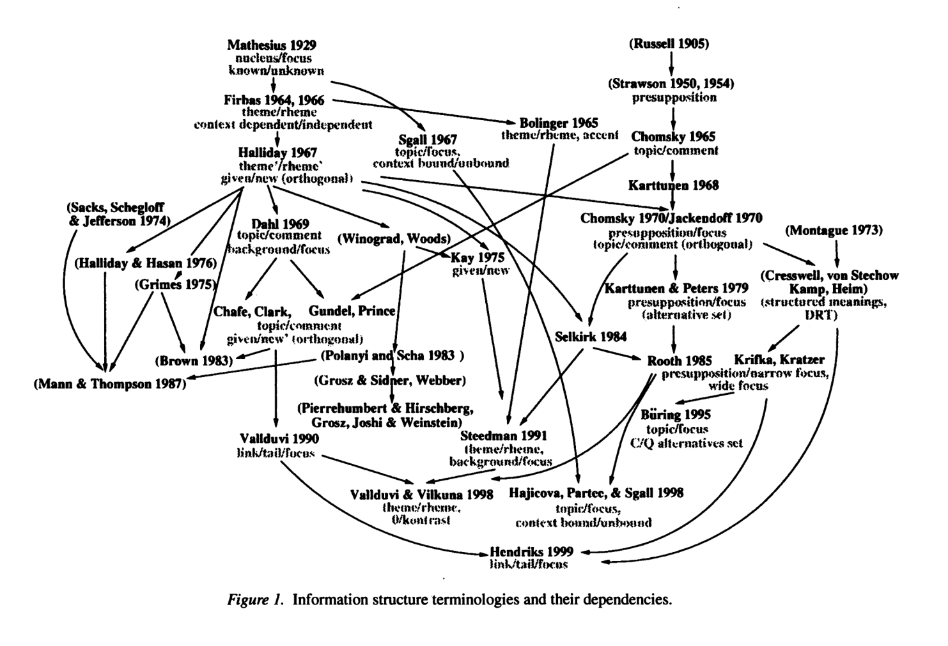

Slide 10
IS: two basic distinctions
Givenness
-What is asserted/new (focus)
-What is assumed/old (background)
Aboutness
-What the utterance is about (topic)
-What the speaker has to say (comment)
(10) a. What does Jane study?
b. Jane studies linguistics.
Background | Focus
Topic | Comment

Slide 11
Linguistic marking of IS
Word Order, Morphology, Phonology etc
Today’s focus (no pun intended) will be:
Givenness: Focus sensitive particles
- only, also, too, even……
Aboutness: Question Under Discussion
- ’What about X?’
‘What other than X also Y?’
etc.

Slide 12
Motivating an ‘pragmatic’ account
Generic readings cross-linguistically common
Yet no known language has a dedicated generic article.
Apparent quantificational variability
GEN posited to do heavy weightlifting
While the observed context-sensitivity lends itself to independent IS notions

Slide 13
Association with Focus
Focus marking highlights a set of contextually induced alternatives to the focus-marked
(11) a. Mary only introduced [Bill]F to Sue.
b. Mary only introduced Bill to [Sue]F.
Let’s now reconsider example (8)
(8) Only PhD holders get tenured.
The other reading component predicted
All ‘alternative’ degree holders not tenured
e.g. ✗Bacholars get tenured
✗ Master holders get tenured

Slide 14
Context-sensitivity to current QUD
Unacceptable BP generics are considerably more felicitous as answers to a current QUD
(12)
a. # Mammals lay eggs.
b. A: What animals lay eggs?
B: Birds lay eggs. Fishes lay eggs. Mammals lay eggs.
QUD concerns the availability/possibility,
Weak existential denotation easily acceptable

Slide 15
Discussion: conceptual advantages
BP generics’ quantificational force is variable
Like, really variable: from weakest to strongest
So positing a strong-as-default semantics is a priori no more plausible than the opposite
A weak-as-default semantics has advantages:
Pragmatics tend to strengthen meanings
e.g. Scalar Implicatures: some vs some b.n. all
Existentiality is unspecified for number
This explains why the question-answer pair probing prevalence conditions is odd in (4)

Slide 16
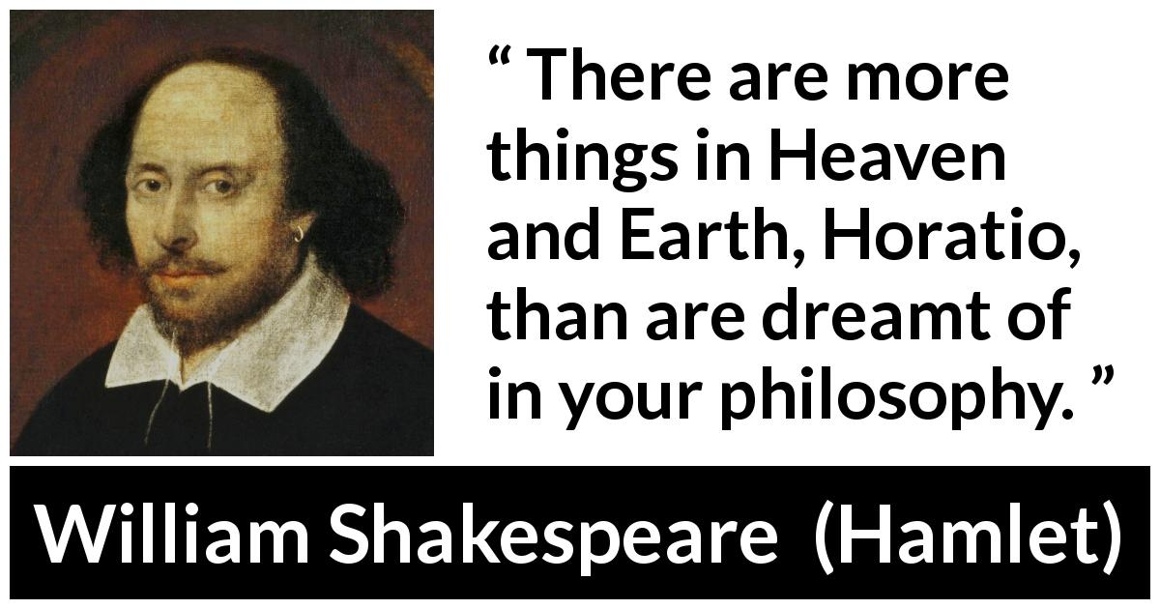
To relieve one of pragmatic burden

Slide 17
Conclusion
Known facts about BP generics:
1. variable quantificational force
2. potential context-sensitivity
Lesser-known facts about BP generics:
1. more variable quantificational force
Specifically, a weak indefinite/existential one
2. systematic potential context-sensitivity
Specifically, manipulated by studied IS factors

Slide 18
Conclusion
Current observations strongly prompt us to abandon the received view of QUH
Together with notions from IS and discourse pragmatics, BP generics can have a default weak existential semantics ∃x (N(x)∧P(x)).
Replace truth-theoretic by felicity conditions
In most instances where a generic is judged to be degraded, they are true in a strict sense.
Interpretational variability explained by the open-ended nature of pragmatic implications

Slide 19
References
Beaver, D. I., & Clark, B. Z. (2008). Sense and Sensitivity: How Focus Determines Meaning. John Wiley & Sons. Büring, D. (2016). (Contrastive) Topic. In C. Féry & S. Ishihara (Eds.) The Oxford Handbook of Information Structure (pp 64-85). OUP. Carlson, G. N., & Francis Jeffrey Pelletier. (1995). The Generic Book. University of Chicago Press. Cohen, A., & Erteschik-Shir, N. (2002). Topic, focus, and the interpretation of bare plurals. Natural Language Semantics, 10(2), 125-165. Cohen, A. (2004). Existential Generics. Linguistics and Philosophy, 27(2), 137-168. von Fintel, K. (1997). Bare plurals, bare conditionals, and only. Journal of Semantics, 14(1), 1-56.
von Fintel, K. (2004). A minimal theory of adverbial quantification. In H. Kamp & B. H. Partee (Eds.), Context-dependence in the analysis of linguistic meaning (pp 137–175). Amsterdam, The Netherlands: Elsevier. Lewis, D. (1979). Scorekeeping in a language game. Journal of Philosophical Logic, 8(1), 339-359. Pelletier, F. J., & Asher, N. (1997). Generics and defaults. In Handbook of logic and language (pp. 1125-1177). North-Holland. Roberts, C. (2012). Information structure: Towards an integrated formal theory of pragmatics. Semantics and Pragmatics, 5(6), 1-69. Rooth, M. (1992). A theory of focus interpretation. Natural Language Semantics, 1(1), 75-116. Sterken, R. K. (2015). Generics in context. Philosopher's Imprint, 15(21). Vallduví, E. (2016). Information structure. In M. Aloni & P. Dekker (Eds.), The Cambridge Handbook of Formal Semantics (pp. 728-755). Cambridge: Cambridge University Press.

Slide 20
Thank you to everyone for listening!
Q & A

