Slide 1
Multilingualism in Crisis Communication:
Use of Minority Languages in COVID-19 Awareness Campaigns in the Netherlands
Zoe Wang
MA Multilingualism
University of Groningen
@71StuTS/31TaCoS

Slide 2
Table of contents
01
02
03
Introduction
Sociolinguistic Background
Theoretical Framework
04
05
Methods
Q & A

Slide 3
Introduction
Why am I interested in this topic?

Slide 4
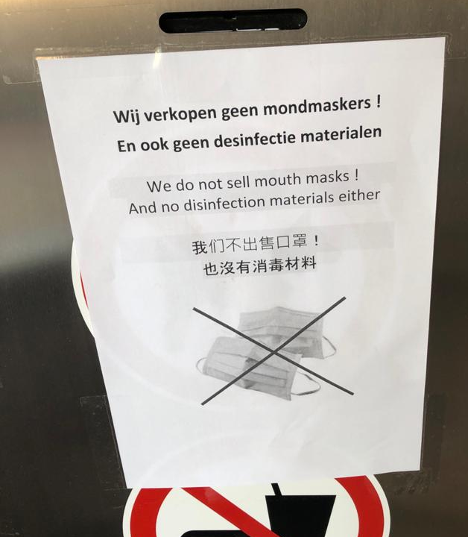
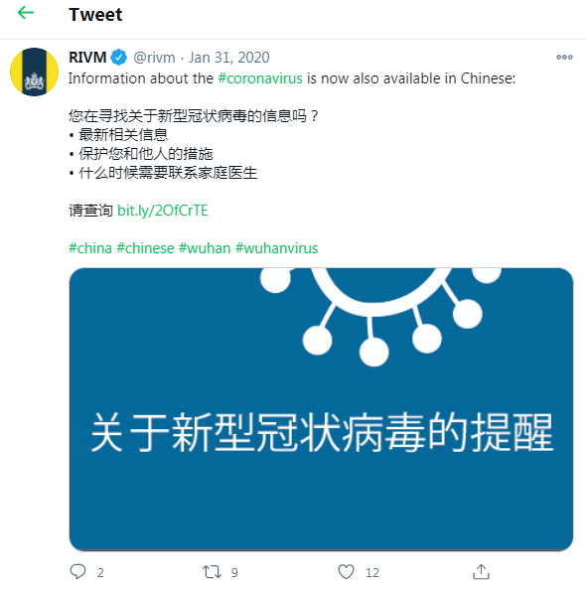

Slide 5
Existing multilingual information
(Arabic, English, and Turkish)
But people I meet at the Taalcafe have different stories

Slide 6
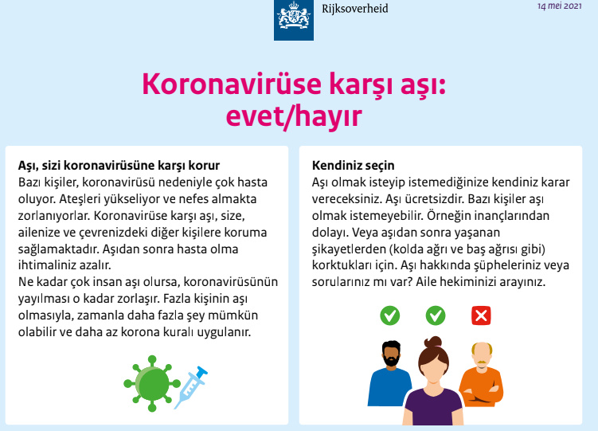
Info provided by the government

Slide 7
Research questions
Availability
Accessibility
Accuracy
1) Was multilingual information on the COVID-19 crisis available for non-Dutch speakers in the Netherlands and how are low-literature Dutch speakers served?
2) In what mode and with which frequency did multilingual populations in the Netherlands receive information concerning COVID-19?
3) To what extent was the crisis information provided for multilingual communities able to build the trust needed for compliance with the updated instructions?

Slide 8
Sociolinguistic Background
What languages are people using in NL?

Slide 9
Official languages
English-mediated multilingualism
Dutch — the official language, 94% of the population (Europeans and their Languages, 2012)
Frisian, Low Saxon and Limburgish — Minority languages (ECRML) (Council of Europe, n.d.)
Government
Companies
Higher education
Media

Slide 10
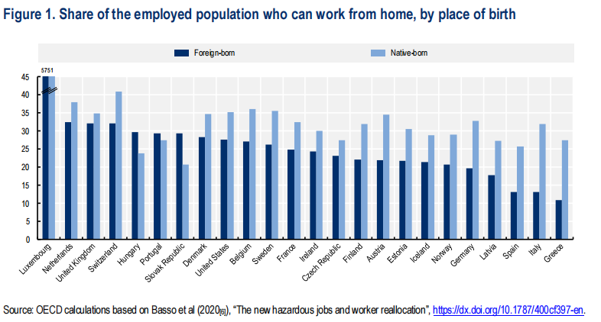
Migrant population and their languages
> 11%
23%
17%
Foreign-born residents
sub-standard accommodations
overcrowded dwellings

Slide 11
“There are a disproportionate number of people of non-Western background among corona patients.”
— Soetenhorst, Het Parool, 2020
In the first six weeks of the corona pandemic in the Netherlands, “……an excess mortality rate of 47% among people with a non-Western background, which is higher than the rate among Dutch natives (38%)”
— CBS, 2020

Slide 12
Theoretical framework
Which theories underpin the research problem?

Slide 13
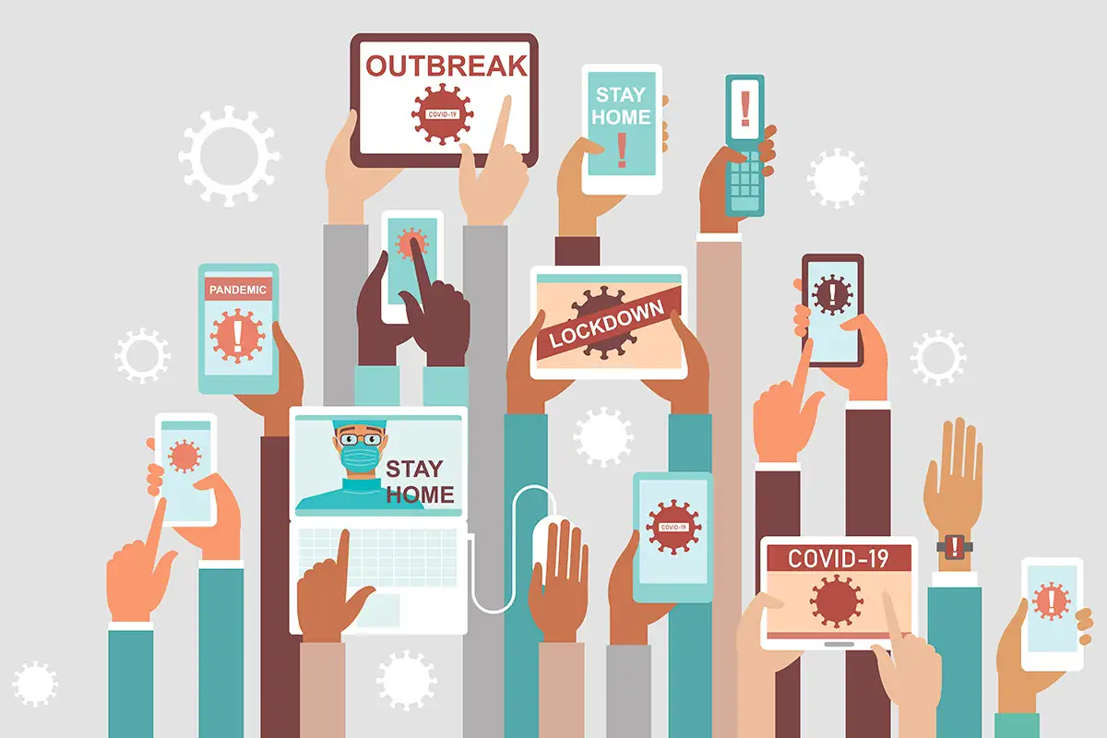
Crisis sociolinguistics
Coombs (2010) defines it as "the collection, processing, and dissemination of information required to address a crisis situation."
During the pandemic, mis-/disinformation amplifies feelings of fear and enhances risks (Kask, 2020). WHO referred to this phenomenon as an "infodemic” (UN, 2020).

Slide 14
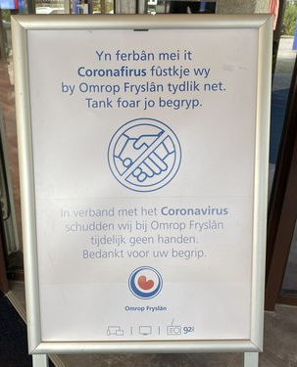
Linguistic diversity &
Linguistic landscape
Operating in one or two national languages cannot ensure that minority language speakers, including low-literate speakers, have access to all necessary information nor that they comply with instructions.
Linguistic landscape formulates informative and/or communicative functions (Gorter, 2006).

Slide 15
Methods
What are the approaches?

Slide 16
Methods
Questionnaire
Interviews
Eye-tracking experiments
Participants are recruited nationwide based on their linguistic backgrounds:
non-Dutch speakers
low-literate L1 Dutch speakers
speakers with Dutch as their L1 and who are not low literate (control group)

Slide 17
References
Basso, G. et al. (2020), “The new hazardous jobs and worker reallocation”, OECD Social, Employment and Migration Working Papers, No. 247, OECD Publishing, Paris, https://dx.doi.org/10.1787/400cf397-en.
Bozorgmehr, K., Hintermeier, M., Razum, O., Mohsenpour, A., Biddle, L., Oertelt ‐ Prigione, S., ... & Jahn, R. (2020). SARS-CoV-2 in reception facilities and collective accommodation for refugees: Epidemiological and normative-legal aspects.
Brun, S., & Simon, P. (2020). Dossier: Inégalités ethno-raciales et coronavirus. De facto, (19).
Coombs, W. T. (2010). Parameters for crisis communication. The handbook of crisis communication, 17-53.
Council of Europe, (n.d.). retrieved from https://www.coe.int/en/web/conventions/full-list/-/conventions/treaty/148 on 19th January, 2021.
Gorter, D. (Ed.). (2006). Linguistic landscape: A new approach to multilingualism. Multilingual Matters.
OECD, (2020). Retrieved from http://www.oecd.org/coronavirus/policy-responses/what-is-the-impact-of-the-covid-19-pandemic-on-immigrants-and-their-children-e7cbb7de on 20th January, 2021.
Piller, I. (2020). Covid-19 forces us to take linguistic diversity seriously. In Gerhard Boomgaarden (ed.), 12 perspectives on the pandemic, 12–17. Berlin: De Gruyter.
Soetenhorst, B. (2020). Retrieved from https://www.parool.nl/amsterdam/ic-arts-coronapatienten-op-intensive-cares-vooral-van-niet-westerse-achtergrond~b290eecc/?referrer=https%3A%2F%2Fdutchreview.com%2F on 20th January, 2021.
Statistics Netherlands, (2020). Retrieved from https://www.cbs.nl/en-gb/figures/detail/37296eng on 21st December, 2020.
United Nations, (2020). Retrieved from https://www.un.org/en/un-coronavirus-communications-team/un-tackling-%E2%80%98infodemic%E2%80%99-misinformation-and-cybercrime-covid-19 on 3rd January, 2021.

Slide 18
Thanks
Do you have any questions or comment?
r.wang@rug.nl
CLCG
University of Groningen
@71StuTS/31TaCoS
Please keep this slide for attribution

