Slide 1
Phonotactic Patterns in L2 English
Wellington Mendes

Slide 2
Phonotactic Pattern
A phonotactic pattern defines possible syllable structure, consonant clusters and vowel sequences (TRASK, 2011).
ˈɪmpækt
wɜːrkt
læft
English word-final /CC/: impact, worked, laughed.
kӕts
dɒɡz
bæɡz
English /Cs/: cats, dogs, bags.
kɾɛps
bɔts
ʃɛks
Brazilian Portuguese /Cs/: crepes, botes, cheques.

Slide 3
English plural suffixes
(also 3rd. p. s. present)
kʌps
kӕts
dʌks
voiceless consonant
s
cups, cats, ducks
dɒɡz
triːz
paɪz
voiced consonant, V or diphthong
z
dogs, trees, pies
bʌsɪz
kwɪzɪz
wɒtʃɪz
sibilants/affricates
ɪz
buses, quizzes, watches
Brazilian Portuguese plural forms
awpis
ʃɛkis
klubis
End in [Vs] when preceded by a consonant
Are prone to regressive assimilation
alpes, cheques, clubes
awpizahʒẽtʃinʊs
alpes argentinos

Slide 4
Aims
Investigate the production of English plural forms by Brazilian speakers, in terms of:
production of [Cs] phonotactic patterns: grapes [ɡreɪps] ~ *[ɡreɪpis].
sibilant voicing: jobs [dʒɔbz] ~ *[dʒɔbs].
Analyse how an ongoing sound change in the L1 affects the production of L2 phonotactic patterns.
Assess how phonological and orthographic representations are related.

Slide 5
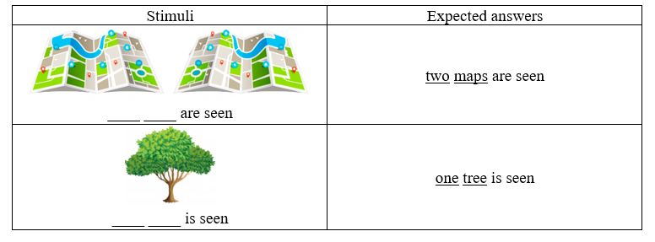
Methodology
A group of 20 High School students who displayed beginner or advanced levels of L2 English took part in this study.
An experiment was designed to assess the production of plural nouns in both L1 Brazilian Portuguese and L2 English.
A picture-counting task and a reading task were adopted.
Sibilants were produced both word-finally and followed by a word-initial vowel.
Sibilants were measured with Harmonics-to-noise ratio (HNR).
The lakes are clean
All maps are lost

Slide 6
[Cs] patterns in Brazilian Portuguese | N | %
Cis | 1017 | 36%
Cs | 1823 | 64%
Study 1: Production of [Cs] ~ [Cis] patterns
[Cs] patterns in English | N | %
Cis | 318 | 11%
Cs | 2519 | 89%

Slide 7
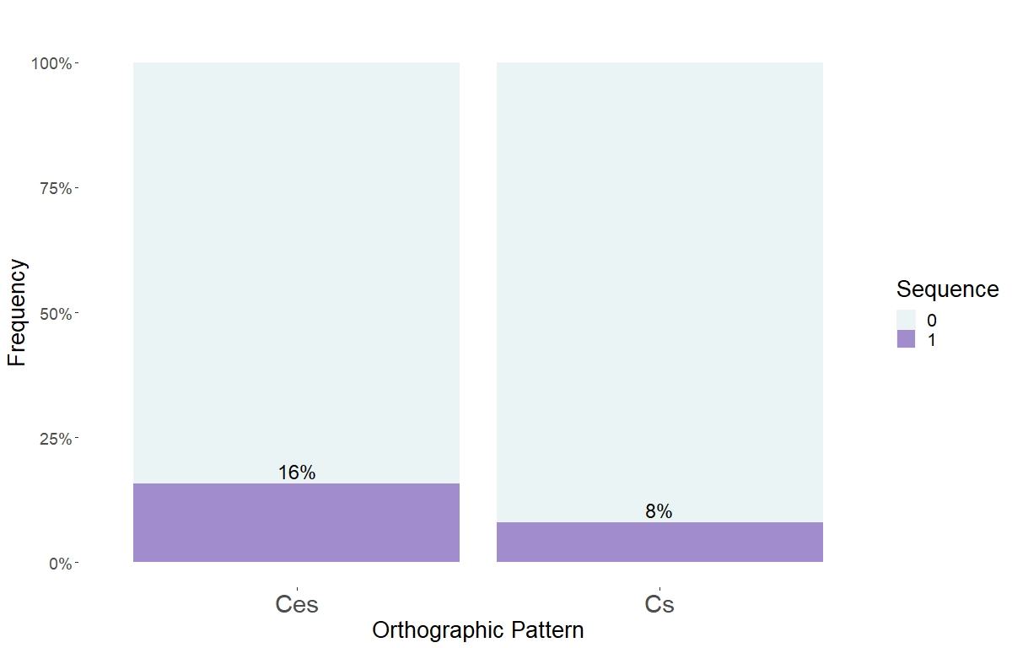
X-squared = 40.218, df = 1, p-value < 0.001
Orthographic Pattern (L2E)
Cs
Cis

Slide 8
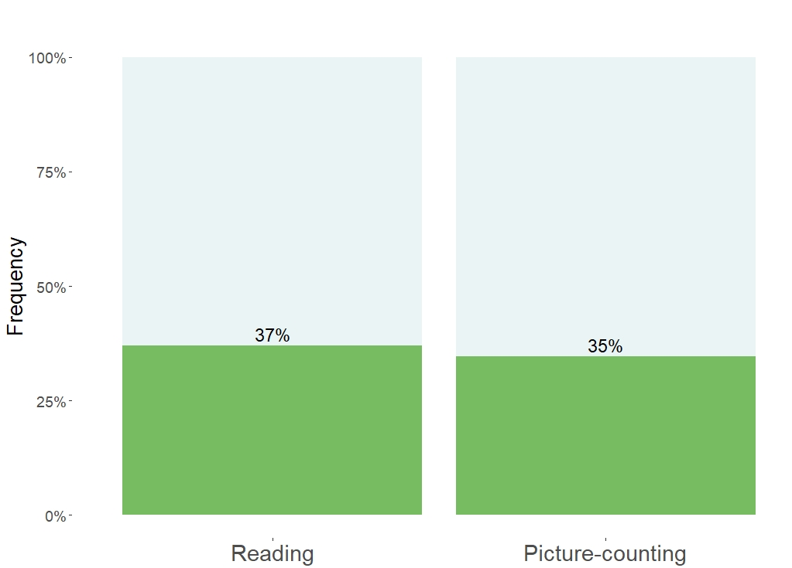
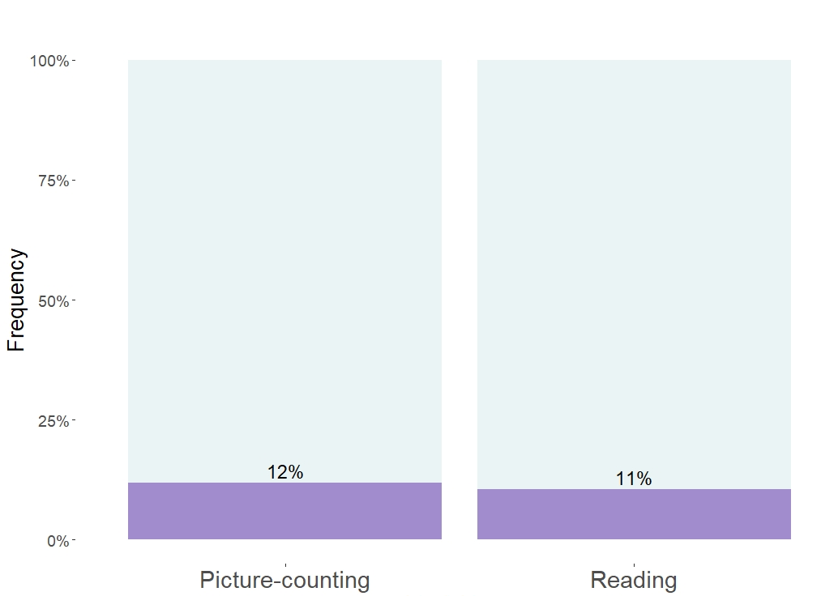
Task Type (BP)
Task Type (L2E)
Cs±
Cs±
Cis±
X-squared = 1.511, df = 1, p-value = 0.219
Cis±
X-squared = 1.1202, df = 1, p-value = 0.2899

Slide 9
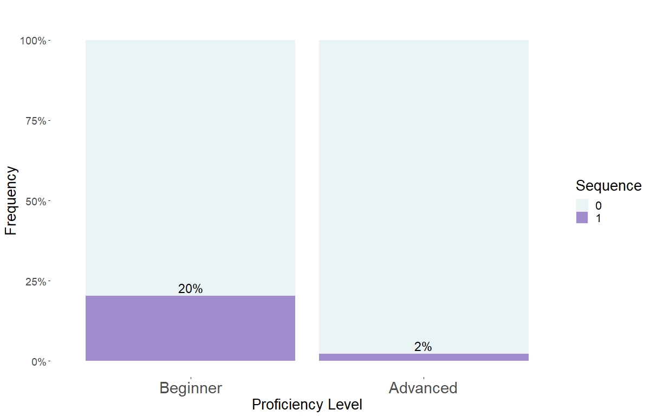
Proficiency Level (L2E)
Cs
Cis
X-squared = 229.73, df = 1, p-value < 0.001

Slide 10
Study 2: Sibilant Voicing

Slide 11
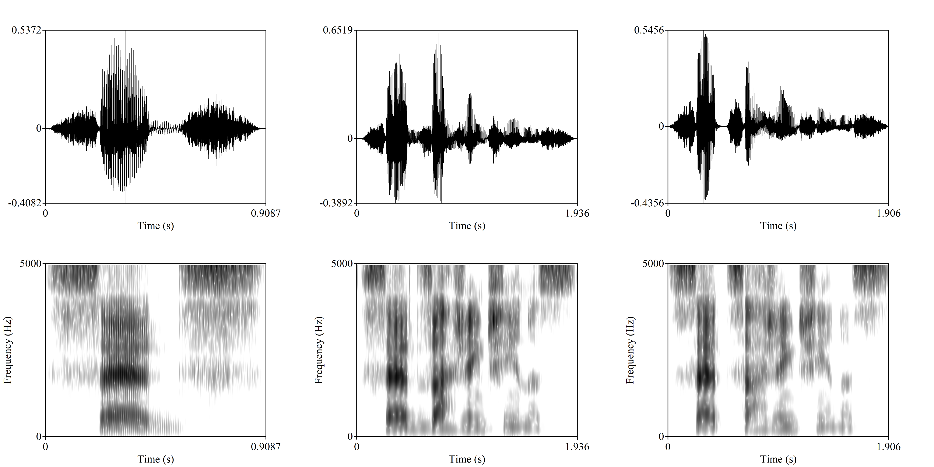
underlying form (stable SP)
regressive assimilation (stable SP)
word-final devoicing (ongoing SP)
s ɛ d s
s ɛ d z ah ʒẽ tʃ i n ə s
s ɛ t s ah ʒ ẽ tʃ i n ə s

Slide 12
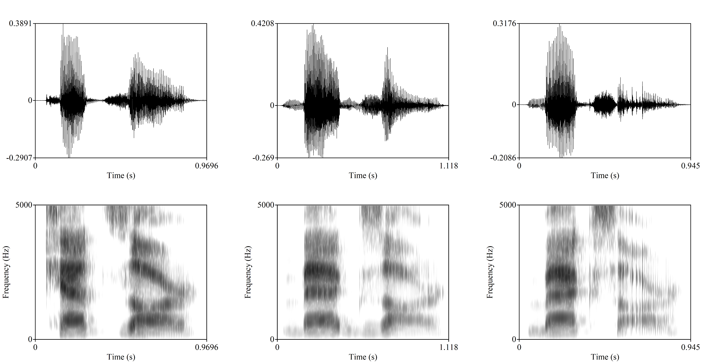
regressive assimilation (stable SP)
word-final devoicing (ongoing SP)
k ӕ t s a r
b ӕ g z a r
b ӕ k s a r

Slide 13
 | Target | N | HNR Mean (dB)
Brazilian Portuguese | /s/ | 1409 | 2.8
 | /z/ | 1424 | 7.9
L2 English | /s/ | 1416 | 2.5
 | /z/ | 1415 | 3.9

Slide 14
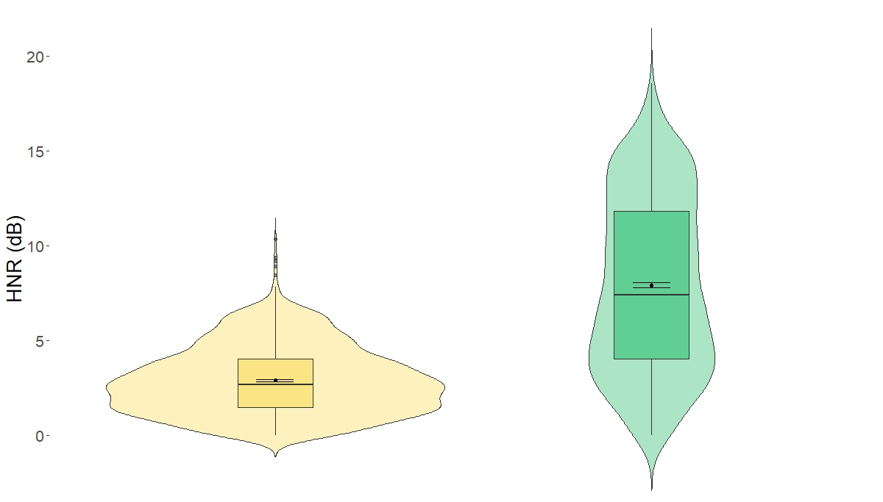
Sibilant voicing per following phonological environment (PB)
Pause
Vowel
W = 340138, p-value < 0.01
Sd = 4.5

Slide 15
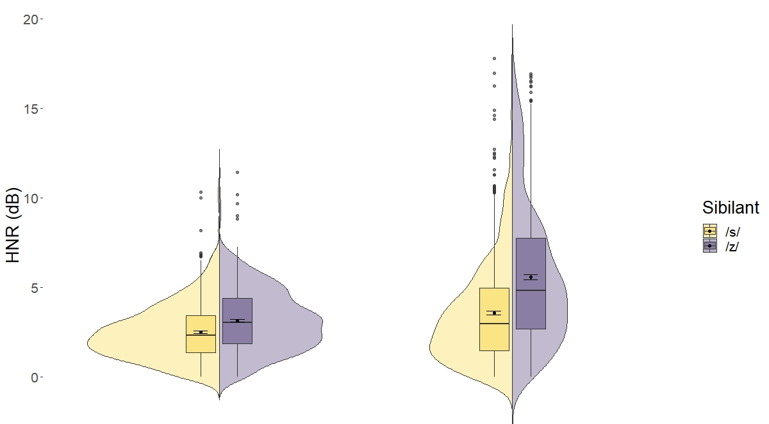
Sibilant voicing per following phonological environment (L2E)
Pause
Vowel
W = 203088, p-value < 0.01
W = 155599, p-value < 0.01

Slide 16
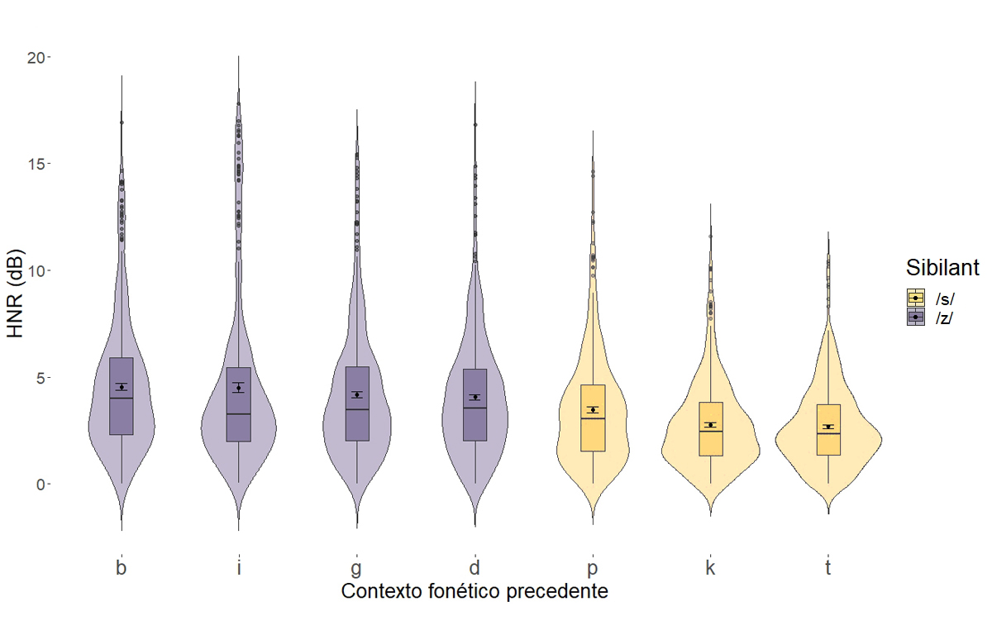
Sibilant voicing per preceding phonological environment (L2E)
χ² = 28.699, df = 3, p-value < 0.001
χ² = 7.6952, df = 3, p-value = 0.04

Slide 17
Final remarks
The production of L2 English phonotactic patterns is influenced by orthography: an epenthetic vowel is more prone to occur when the pattern is <Ces> rather than <Cs>.
Visual access to orthographic forms did not influence a vowel to occur, suggesting that orthographic patterns have a permanent impact on literate individuals’ mental representations.
HNR is strongly influenced by phonetic environments, including preceding epenthetic vowels.
[z] poses a challenge to Brazilian speakers of L2 English, since it has no exemplars from the L1.
Robust patterns from the L1 are adopted in the L2, including both subphonemic properties and ongoing sound changes.

Slide 18
Thank you!
wellington.matt@gmail.com

Slide 19
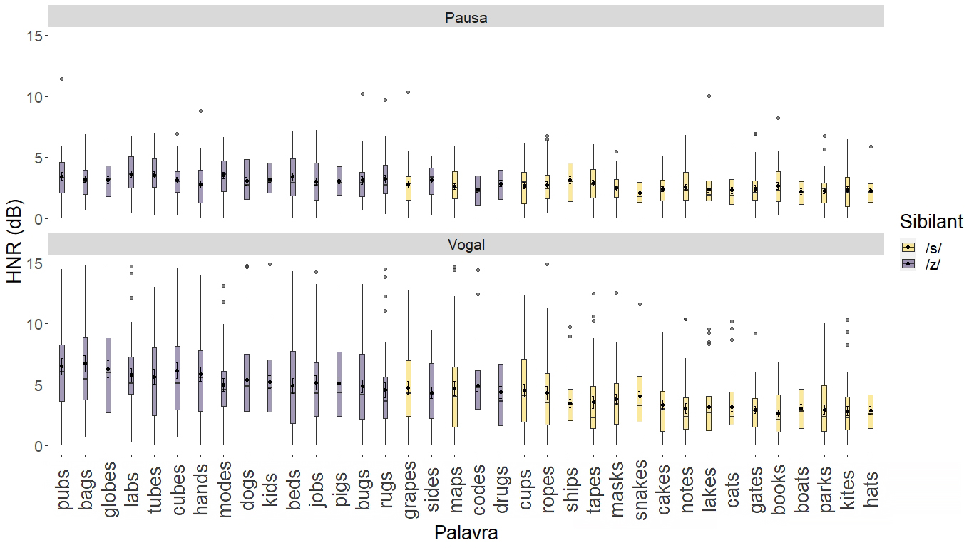
Sibilant voicing per word (L2E)

Slide 20
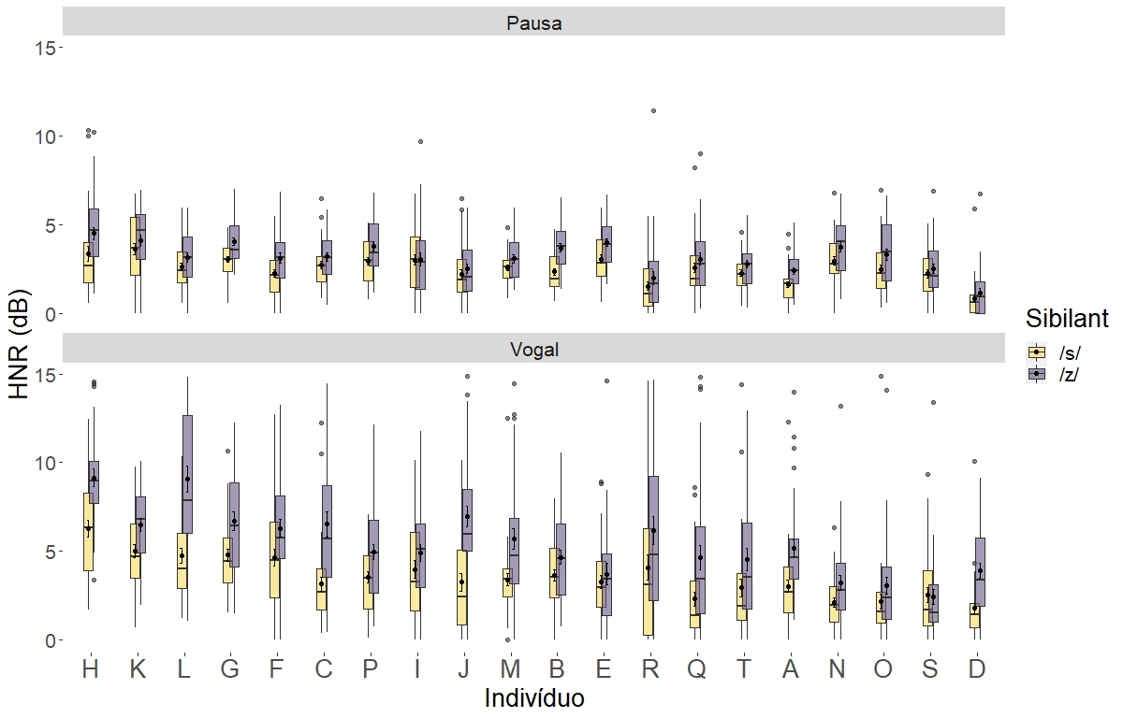
Sibilant voicing per individual (L2E)

