Slide 1
“This could be difficult only”: Investigating Indian English “only” in postpositive position
Anne Visser
Contact: a.visser2@uu.nl

Slide 2
Indian English allows “only” in positions where no other variety of English allows it

Slide 3
Research questions
Question one
How does the lexical item “only” end up in this position in Indian English?
Question two
How do its origins affect its meaning in postpositive position?

Slide 4
Current analysis: postpositive “only” is a calque
“The free lexical morphemes only and itself are calques for the substrate enclitic focus markers. They are stripped of the selection restrictions from the source language and take over the syntax and semantics of the substrate forms.”
Lange (2007), p. 144
“only” is a presentational focus marker in IndE

Slide 5
The Hindi equivalent of “only”: hii (ही)
Hii always appears with right focus (in postpositive position)

Slide 6
Possible positions for “only”
Standard English
It’s ______ 300 rupees.
Indian English
It’s ___1___ 300 rupees ___2___.
Provided by Standard English
Provided by substrate language

Slide 7
Problem 1: Overgeneration of postpositive options
Tomorrow ___1___ we ___2___ play ___3___ cricket ___4___
Tomorrow only we play cricket
Tomorrow we only play cricket
Tomorrow we play only cricket
Tomorrow we play cricket only
In other words: postpositive “only” is restricted in its use.

Slide 8
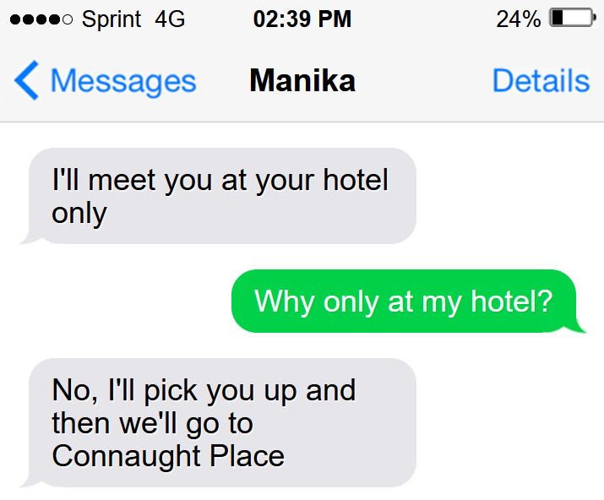
Problem 2: A shift in meaning
I’ll meet you only at your hotel
=/=
I’ll meet you at your hotel only

Slide 9
Refining the environment
Three options:
Clause final position
“She is Rajasthani only” (Lange, 2007)
Final position in temporals (AdvP or PP)
“I’ll confirm the timings tomorrow only”
Final position in locatives (AdvP or PP)
“I’ll meet you at your hotel only”

Slide 10
Five options for “only” in Indian English
Standard English left focus Exclusive
Indian English locative postpositive Presentational
Indian English temporal postpositive Presentational
Indian English clause final postpositive Presentational
Standard English right focus Exclusive

Slide 11
Uncovering “only”’s meaning: back to the substrate influence
Hindi “hii” is seen as equivalent to English “only”
Lange (2007): “only” takes over the semantics of the substrate form and becomes a presentational emphasis marker
In other words: this “only” has no lexical meaning of its own in IndE postpositive.

Slide 12
Possible interpretations of “hii”
Three types of meaning:
Exclusivity
Scalarity
Intensification (emphasis)
Which meaning is used depends on the class of the word is accompanies. A few examples:
NP + hii = “only” (Standard English interpretation)
Non-finite verb + hii = “as soon as”
Adj + hii = intensifier
(Parghi, 2016; Bajaj 2016)

Slide 13
As below, so above
I’ll confirm the timings tomorrow only
Temporal (AdvP)
“not until tomorrow”, pinpointing a moment in time
I’ll meet you at your hotel only
Locative (PP)
Emphasis: That is our meeting point!
This could be difficult only
Clause final following an adjective
Intensification: This could be difficult!

Slide 14
“Hii” is “only”, even when it is not
“Hii” can be translated as “only”
“Hii” can be an emphasis marker → untranslatable
“Only” is already linked to the item “hii” and is therefore selected in other situations too.
Semantic broadening in specific environments.

Slide 15
Conclusion
Substrate influence enables use in postpositive position
Environments for postpositives are restricted (temporal, locative, clause-final)
Its meaning depends on the class of the word or phrase it accompanies
Semantic broadening due to substrate influence: exclusivity, intensification, emphasis marking

Slide 16
References
Bajaj, V. (2016). Scaling up exclusive -hii. [Doctoral dissertation, Rutgers University]. RUcore: Rutgers University Community Repository.
Lange, C. (2007). Focus marking in Indian English. English World-Wide, 28(1), 89-118. doi: 10.1075/eww.28.1.05lan
Mahanta, S. (2015). The use of particles in Hindi and Assamese. International Journal of Research in Social Sciences and Humanities, 5, 113-124.
Parghi, K. (2016). On distribution and senses of the emphatic particle hI in Hindi. Bulletin of the Deccan College Research Institute, 76, 93–100.

